Slide 1
Explaining predictions of any model
Why did the model predict the “green” class?
a (non-expert) end-user
a new instance
INPUT
PREDICTION
?
A Model
Model can be treated as black-box.

Slide 2
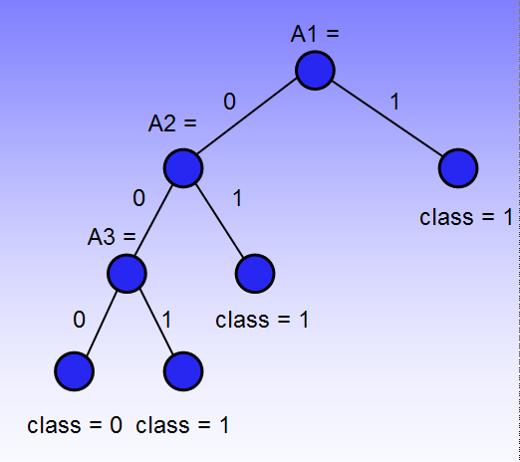
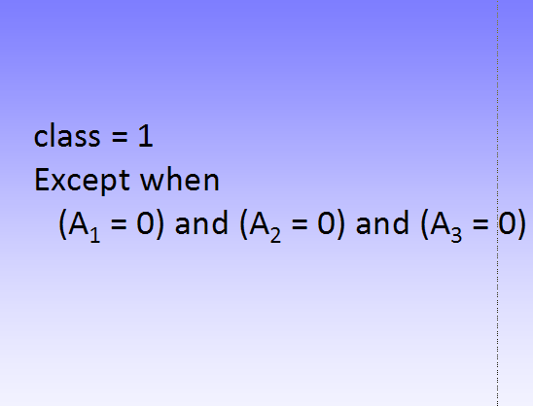
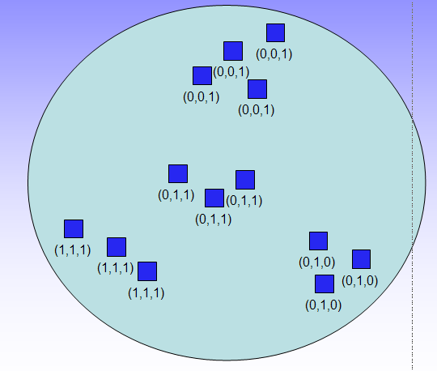
The need for a generalized approach
The user might have to adapt to a new explanation method
if the existing model is replaced with a new (and better) one.
Sometimes, different types of models are used by the same user for different tasks.

Slide 3
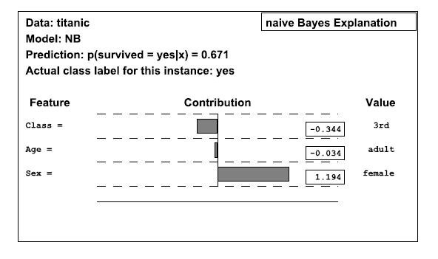

Slide 4
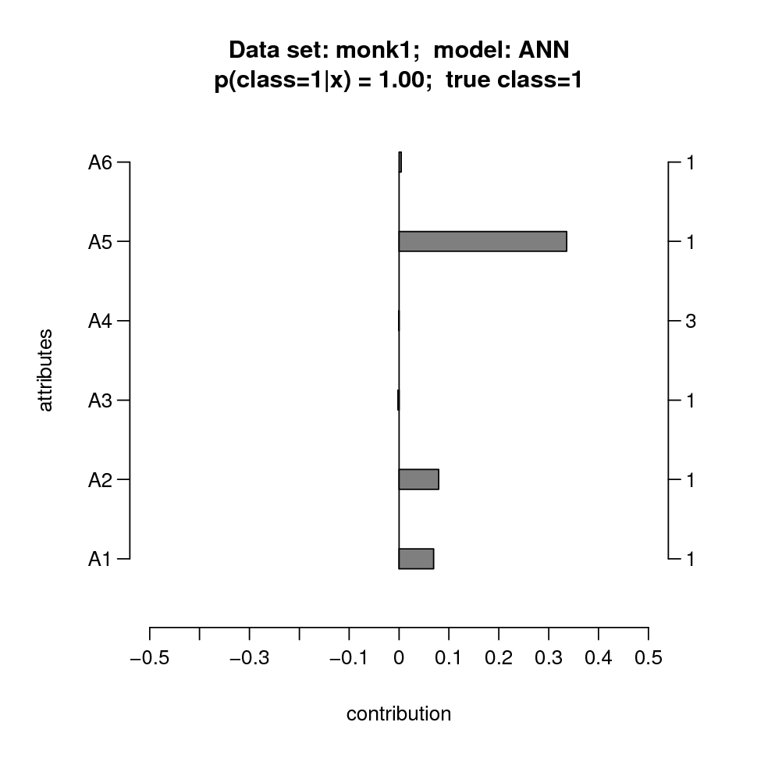
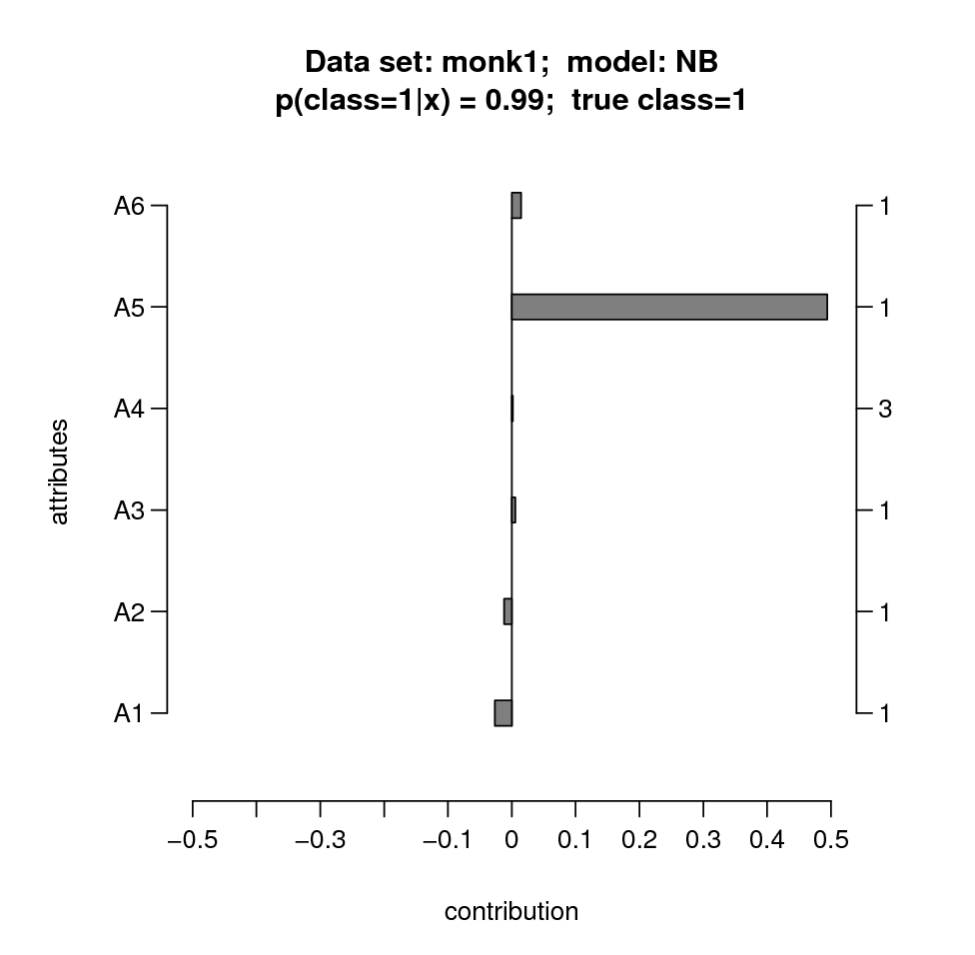
monks1 dataset
432 instances
3 relevant features (A₁, A₂, A₅)
3 irrelevant features (A₃, A₄, A₆)
binary class value
class <- (A₁ = A₂) OR (A₅ = 1)

Slide 5
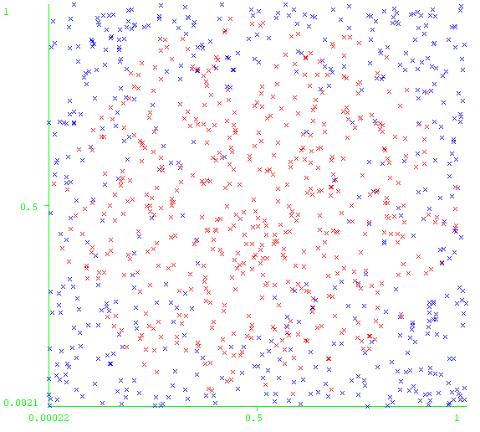
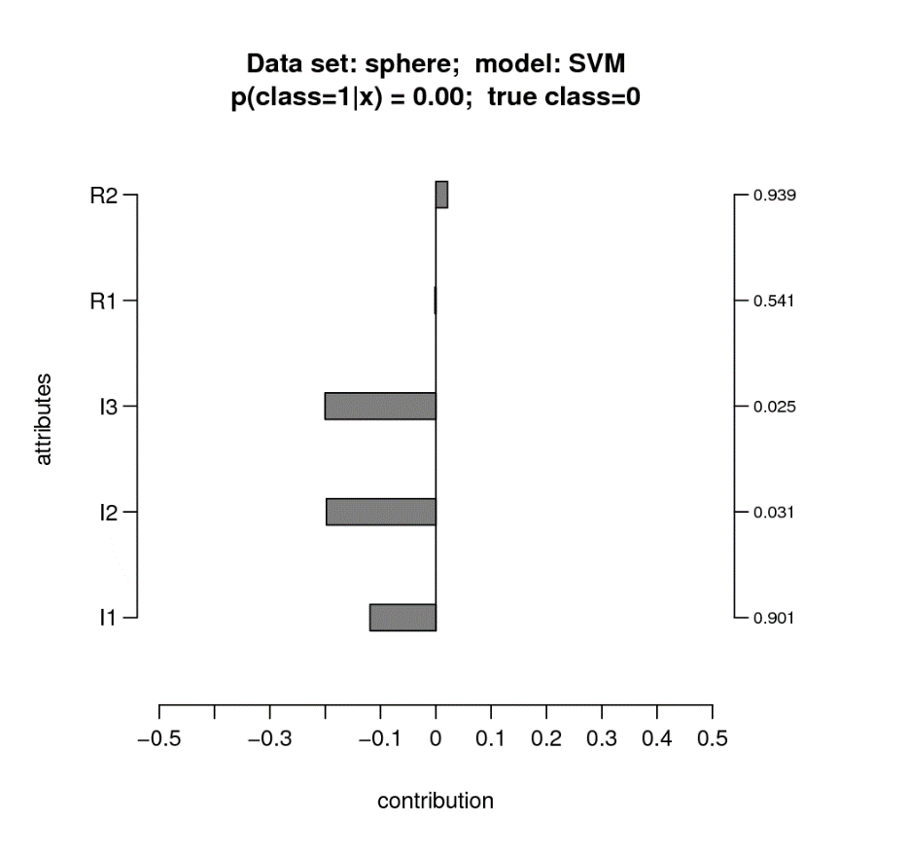
sphere dataset
1000 training instances
3 relevant features (xyz)
2 irrelevant features
binary class value
A₂
A₁

Slide 6
sphere dataset
We can merge individual explanations into a “model explanation”:

Slide 7
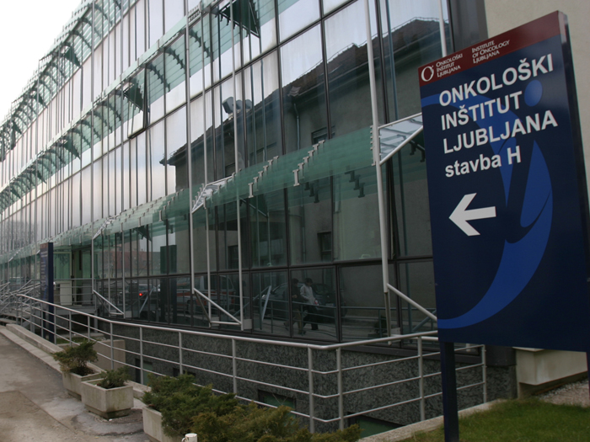

Medical Prognosis
Menopause?
Tumor stage
Tumor grade
Histological type
Progesterone receptor lvl.
Invasive tumor type
Number of positive lymph nodes
Hormonal therapy?
Chemotherapy?
Family medical history
Lymphovascular invasion?
Estrogen receptor lvl.
Size of max. removed node
Ratio of positive lymph nodes
Age group
class1 class2 menop stage grade hType PgR inv nLymph cTh hTh famHist LVI ER maxNode posRatio age
300 11.82 0 1 2 2 1 0 0 1 1 0 3 0 1 2 3 2
301 4.89 1 0 1 2 1 0 0 2 1 0 0 0 2 1 4 3
302 14.63 0 1 1 4 2 0 0 0 0 0 1 0 1 1 1 3
303 21.83 0 0 1 4 2 1 0 1 0 0 9 0 4 1 2 2
304 19.87 0 0 1 2 1 0 0 0 0 0 0 0 1 2 1 2
305 7.54 0 1 2 3 1 9 2 1 0 1 1 0 3 3 3 4
306 15.15 0 0 1 4 2 1 0 0 0 0 2 0 4 1 1 2
307 0.30 1 0 2 2 1 0 0 3 0 0 9 0 1 1 4 2
308 12.49 0 1 2 2 3 1 0 0 0 0 0 0 4 1 1 5
309 1.77 1 0 2 3 1 1 2 2 1 0 9 1 3 3 3 2
Oncologists use these attributes for prognosis in every-day medical practice.

Slide 8
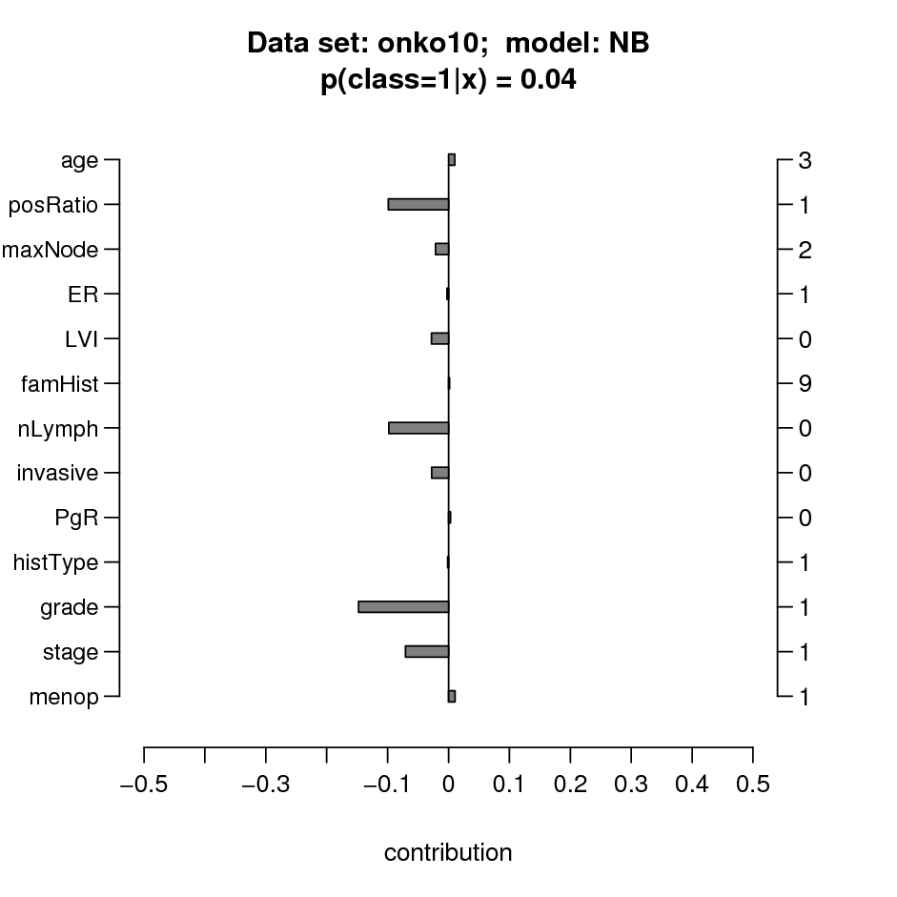
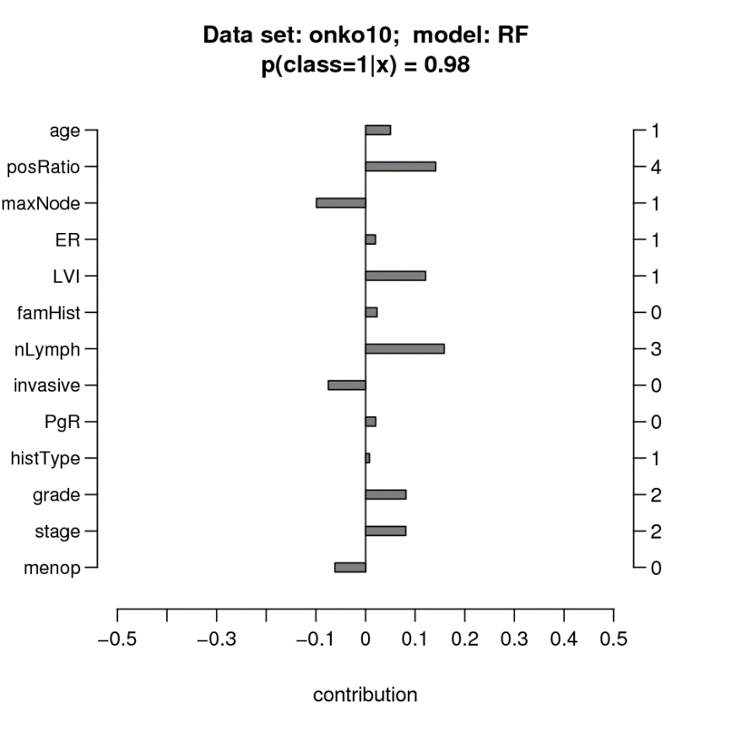
Explaining a Prognosis

Slide 9
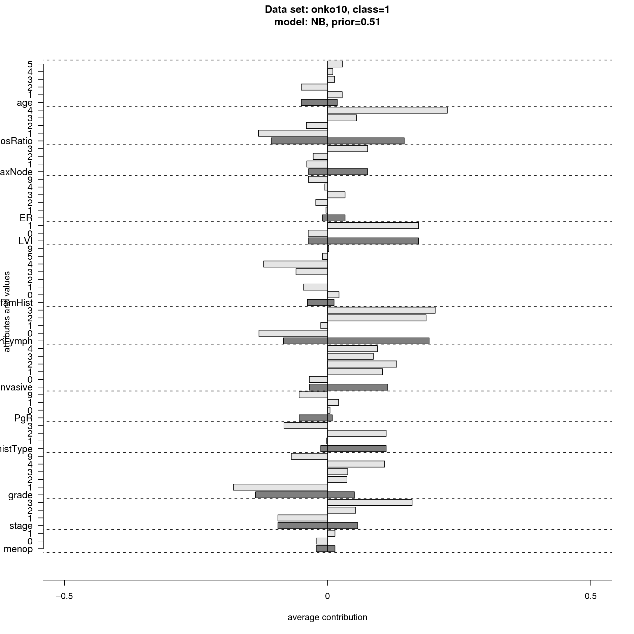
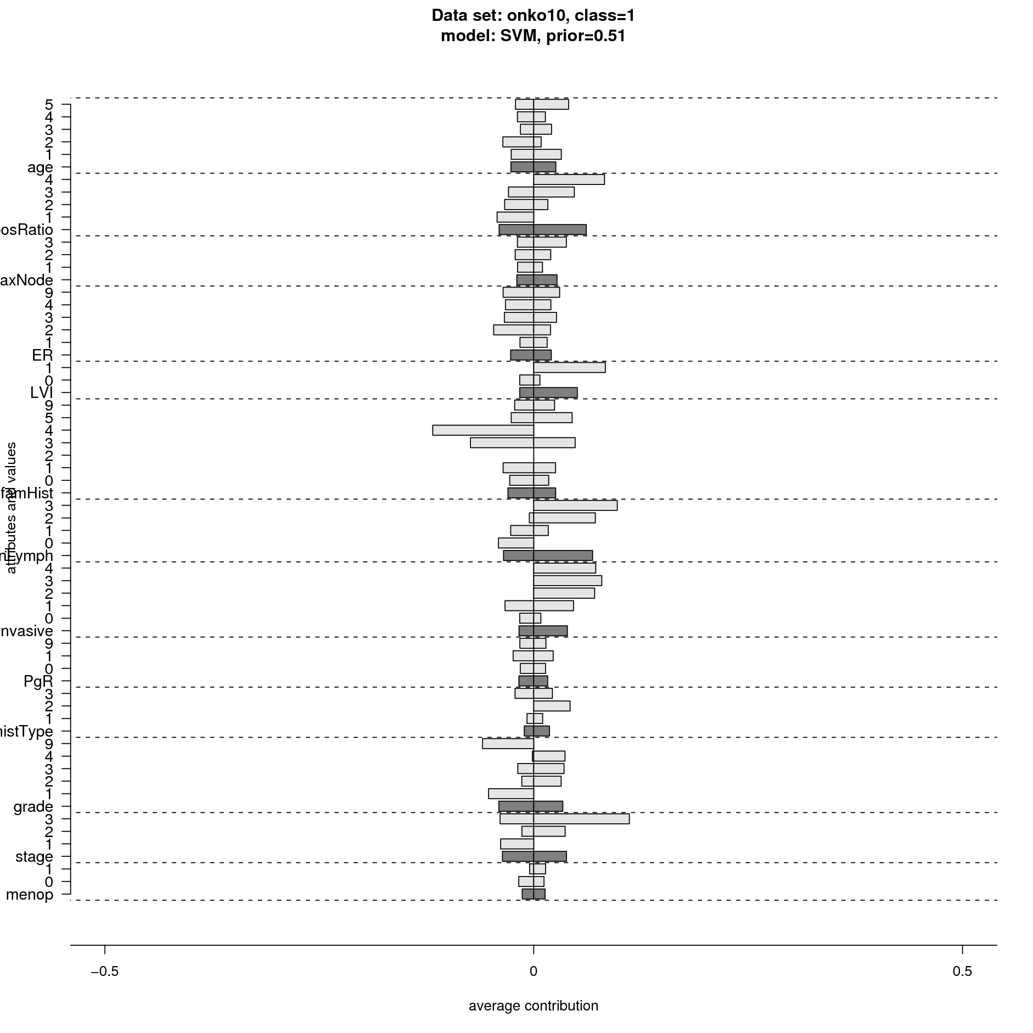
An Overview of the Model

Slide 10
Properties of explanation:
Simple, easy to understand
General, model independent
Takes into acount attributes interactions
Efficient approximation of optimal explanation
Single instances and whole models
Classification and regression

